Slide 1
SMART CONTRACT FUZZING ENHANCING SECURITY IN BLOCKCHAIN APPLICATIONS
- Saurabh Loya (u1472299)
- Anushk Vijayvargiya (u1472411)

Slide 2

WHAT IS SMART CONTRACT?
A "smart contract" is a program that that directly and automatically controls the transfer of digital assets between the parties under certain conditions.
Runs on the Ethereum blockchain.
It's a collection of code (its functions) and data (its state) that resides at a specific address on the Ethereum blockchain.

Slide 3
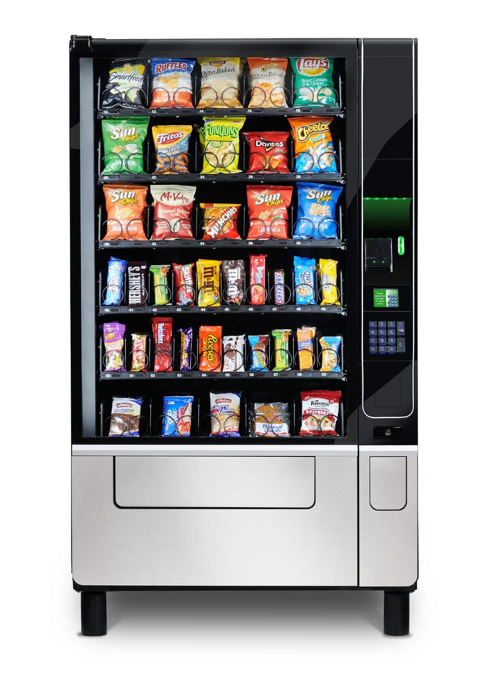
VENDING MACHINE AS A SMART CONTRACT
To get a snack from a vending machine:
snack selection + money = snack dispensed
A smart contract, like a vending machine, has logic programmed into it.

Slide 4
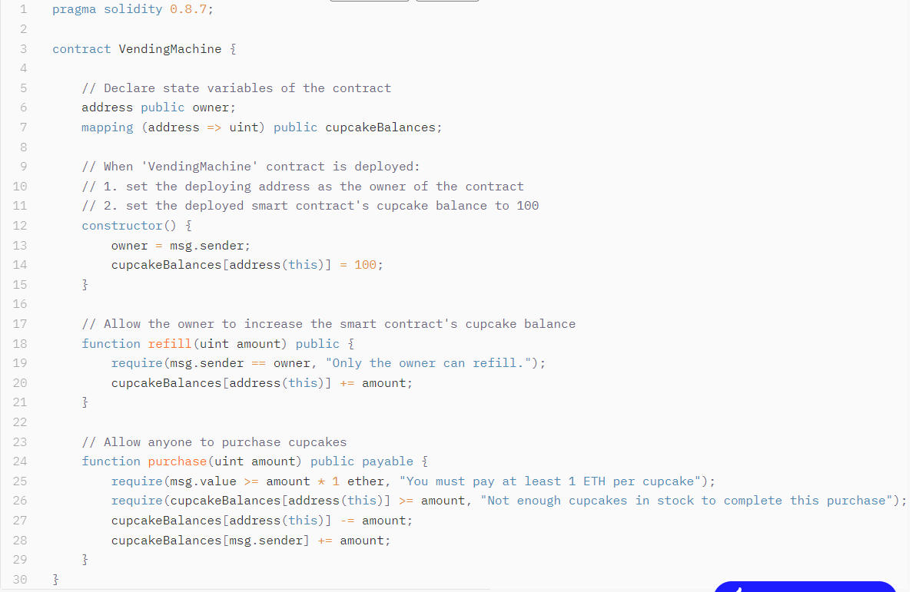

Slide 5
MOTIVATION
Smart contracts are written in error-prone programming languages such as Solidity and programming flaws in these contracts have led to significant financial losses.
Ethereum operates on open networks where everyone can join without trusted third parties.
Hence, smart contracts are attractive and easy attack targets for adversaries to gain financial profits.
By identifying vulnerabilities through smart contract fuzzing, we aim to bolster the security posture of blockchain applications, fostering trust and adoption in decentralized systems.

Slide 6
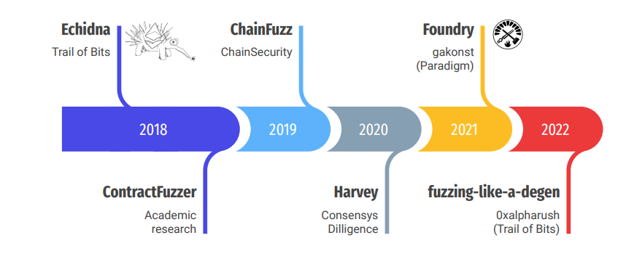
FUZZERS

Slide 7
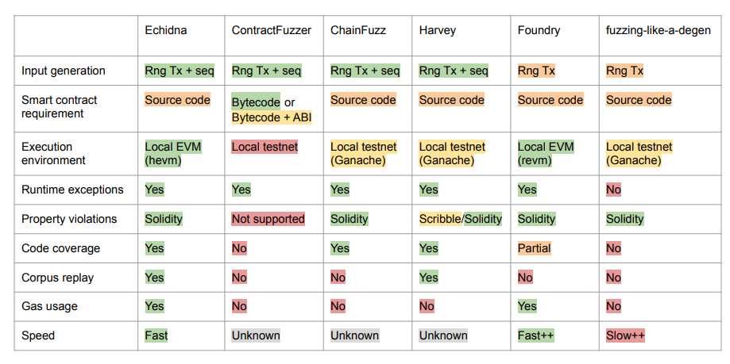
WHICH ONE TO CHOOSE?

Slide 8
ECHIDNA
Developed by Trail of Bits, Echidna is an advanced smart contract fuzzer designed to automate the testing process and uncover vulnerabilities in Ethereum-based smart contracts.
Key features of Echidna include:
Automated test case generation: Echidna generates inputs to systematically explore the behavior of smart contracts, uncovering potential vulnerabilities.
Mutation strategies: Echidna applies mutation strategies to inputs, such as flipping bits or changing values, to trigger edge cases and uncover hidden bugs.
Seamless CI/CD Integration: Echidna is well suited for integration into CI/CD pipelines, allowing developers to automate the fuzzing process.

Slide 9
IMPLEMENTATION
We will begin fuzzing with the generation of various inputs, including transaction sequences and payloads, designed to interact with the target smart contracts under test.
An execution engine will be employed to execute the code of smart contracts, simulating transactions and interactions with the Ethereum Virtual Machine (EVM).
Monitor the execution of smart contracts and detect anomalies, such as unexpected behaviors or security vulnerabilities.
We will also incorporate code coverage monitoring to track the bytecode executed during fuzzing, corpus replay functionality to allow for the re-execution of previously generated inputs and Gas usage monitoring to analyze the consumption of gas during smart contract execution, identifying potential inefficiencies or abnormal patterns indicative of vulnerabilities.

Slide 10
EXPECTED OUTCOME
The expected outcome includes the identification of potential vulnerabilities in smart contracts such as Reentrancy, DoS, Integer overflow/underflow, etc.
By uncovering these vulnerabilities proactively, we anticipate a significant reduction in the incidence of smart contract exploits and associated financial losses.

Slide 11
THANK YOU

